Slide 1
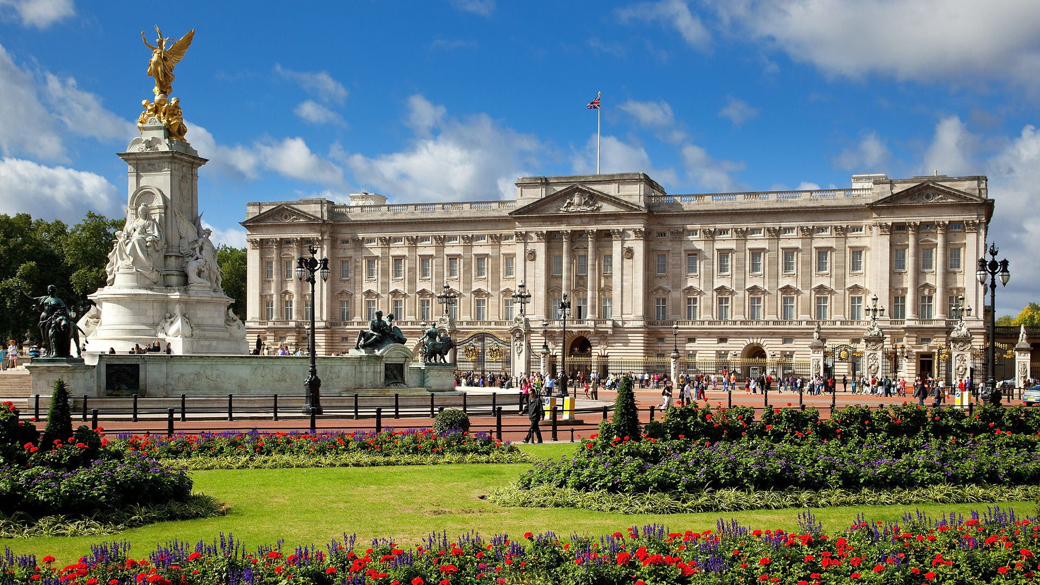
Buckingham Palace

Slide 2
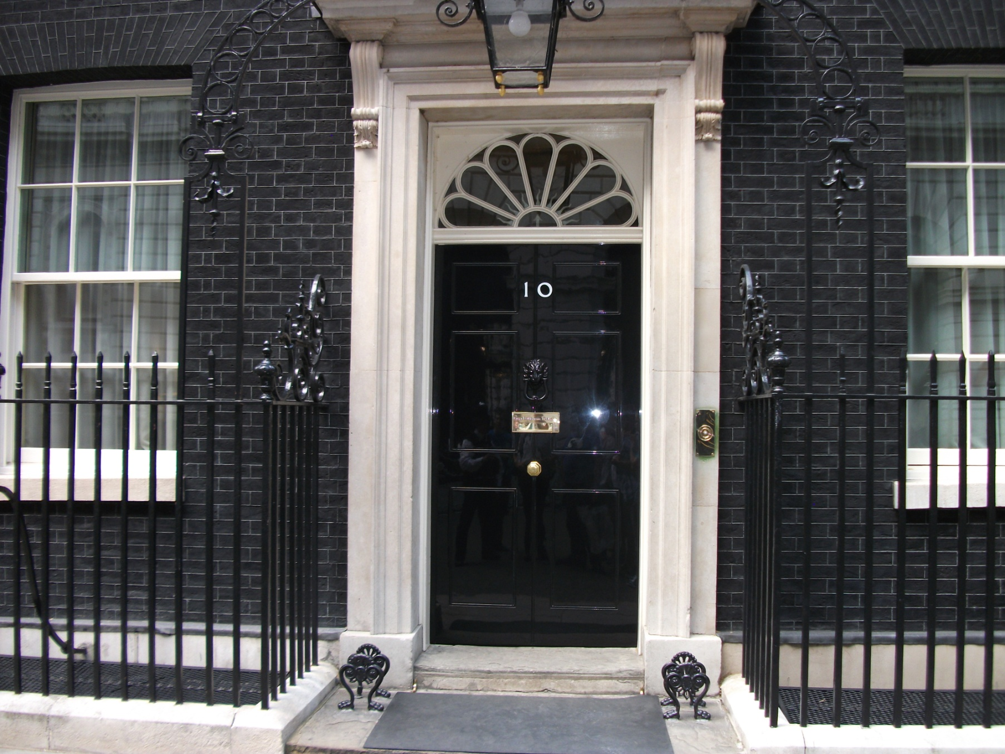
10 Downing Street

Slide 3
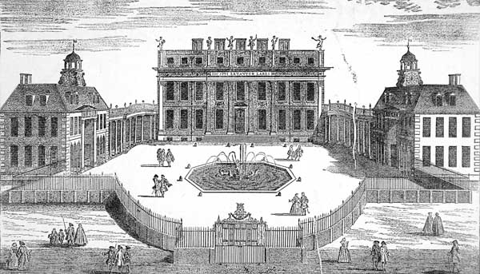
Buckingham Palace in 1710

Slide 4
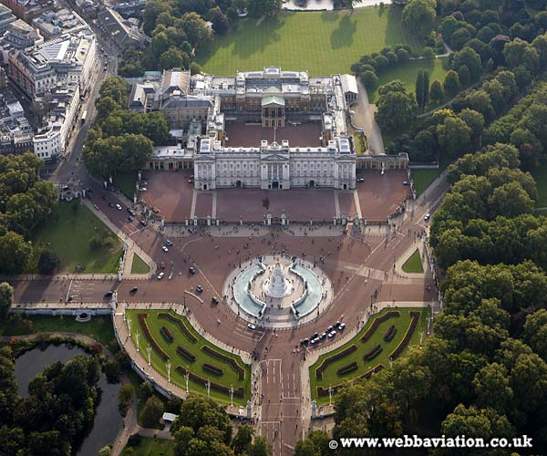
Buckingham Palace now

Slide 5
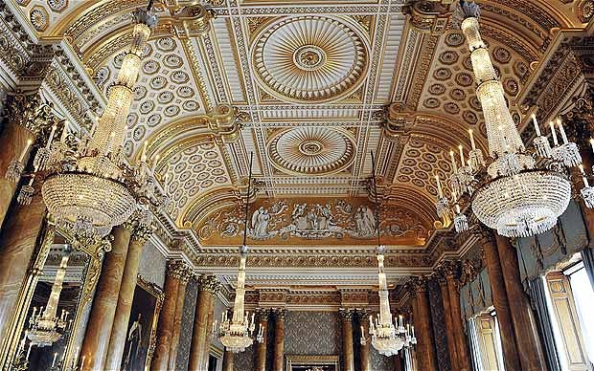
Buckingham Palace inside

Slide 6
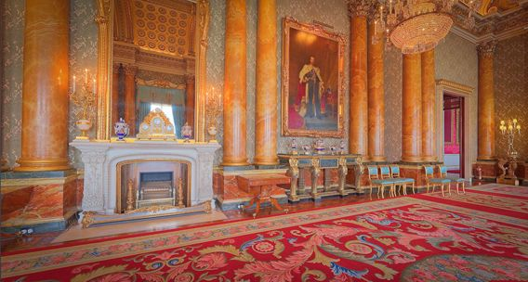
Buckingham Palace inside

Slide 7
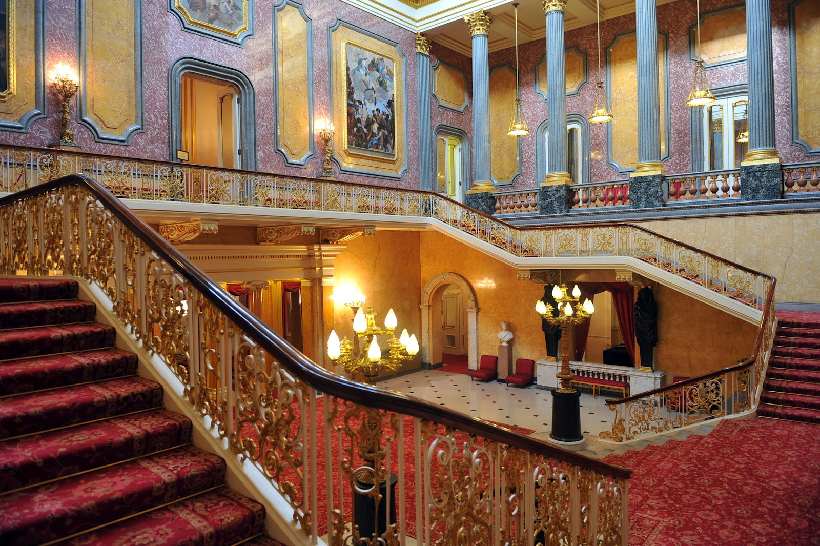
Buckingham Palace inside

Slide 8
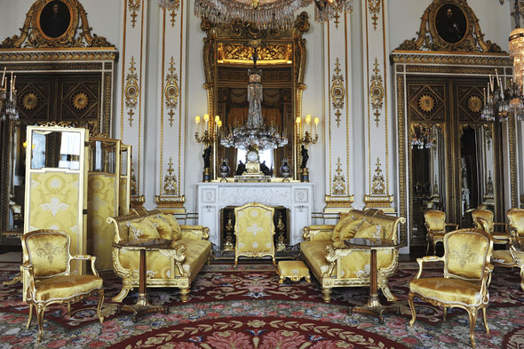
Buckingham Palace inside

Slide 9
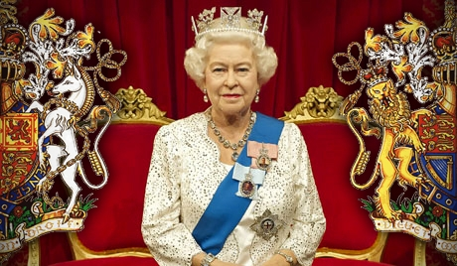
The Queen Elizabeth II

Slide 10
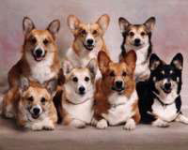
The Royal Dogs

Slide 11
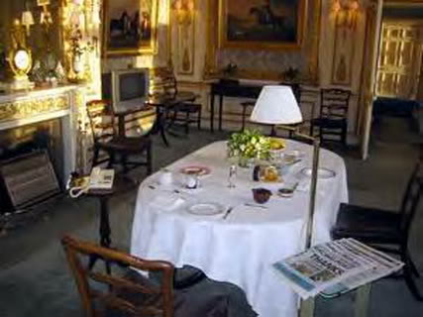
Queen’s Breakfast

Slide 12
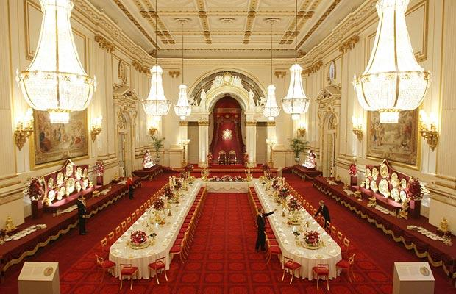
Dinner

